Slide 1
Neural Networks II
Tomas Karpati MD tc.datascience@gmail.com
054-2002430

Slide 2
Neural Networks
Input layer
Data dimensions
1D: Iris, mtcars, titanic, etc
2D: gray-scale images (19x19, 256x128, 1024x1024, etc)
3D: colored images - RGB (19x19x3, 256x128x3, etc)
Multiple: CT/MRI data, videos, etc (256x256x3x30)
Data normalization
z-score normalization: ( xi - mean(X) ) / sd(X)
min-max scaling: ( xi - min(X) ) / (max(X) - min(X))

Slide 3
Neural Networks
Hidden Layers
Dense layer: also known as “fully-connected” layer, is a linear operation in which every input is connected to every output by a weight (so there are n_inputs * n_outputs weights). Generally followed by a non-linear activation function.

Slide 4
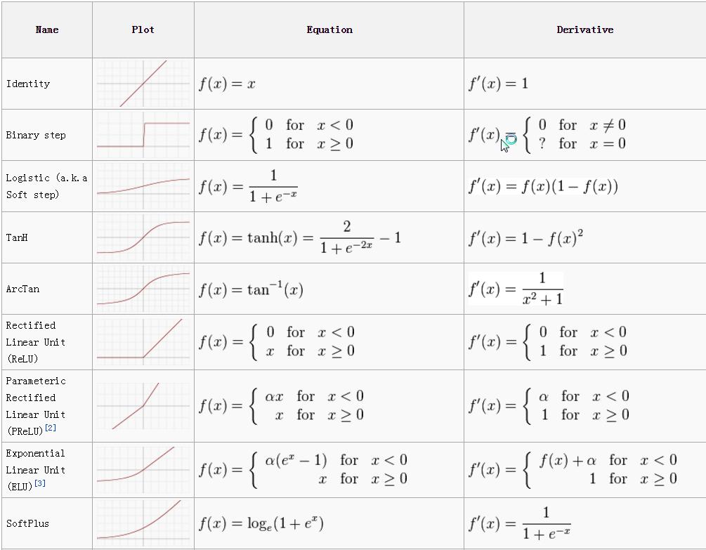
Neural Networks
Activation layer:
Function to apply after dense layer. This could be defined as a parameter inside a dense layer. The most common are: sigmoid, tanh and relu.

Slide 5
Neural Networks
Dropout: at each pass silence some of the inputs.
Common values for dropout are between 20-30%. This can be used with any type of previous layers.
The dropout node is selected randomly.
On training the input is not used, but in test it is given a constant weight (commonly 0.5).
It is recommended to begin training the data without dropout, and when an optimal layer is obtained, then dropout is introduced.
The main goal of dropout is to prevent overfitting.
This cause the following layers to adapt to the situation by changing the weights to compensate for the lack of some inputs.

Slide 6
Neural Networks
Pooling layer: Replace each patch in the input with a single output, which is the maximum (can also be average) of the input patch.
layer.MaxPooling2D(pool_size=(2, 2),( [ 1, 4, 8, 6 ],
[ 6, 3, 5, 4 ],
[ 8. 6. 7, 1 ],
[ 3, 1, 1 ,1 ]) )
> [ 6, 8 ],
[ 8, 7 ]

Slide 7
Neural Networks
Masking: A masking layer has to be composed 3 dimensional input tensor with the shape: (samples, timesteps, features)
The masking is activated when all the three dimension on the input has a value over the masking value (default=0). The result of masking is that the input will be set all to zero.
layer.mask( [ 1, 4, 8 ], [ 6, 3, 5 ], [ 8. 6. 7 ], mask_value=5)
> [ 1, 4, 8 ], [ 6, 3, 5 ], [0. 0. 0 ]

Slide 8
Neural Networks
Reshape: The reshape layer reshapes input to a new shape. The number of dimensions however must remain the same.
layer.reshape( dims=(3,-1), [ [ 1, 4, 8, 6, 3, 5, 8. 6. 7 ] ])
> [ [ [ 1, 4, 8 ], [ 6, 3, 5 ], [ 8. 6. 7 ] ] ]

Slide 9
Neural Networks
Permute: this layer transformation rearrange the dimensions of the inputting previous layer.
layer.permute( dims=(2, 1), [ [ 1, 4, 8 ], [ 6, 3, 5 ] ])
> [ [ [ 1, 6 ], [ 4, 3 ], [ 8, 5 ] ] ]

Slide 10
Neural Networks
Flatten: The reshape layer reshapes input to a new shape. The number of dimensions however must remain the same.
layer.flatten(), [ [ [ 1, 4, 8 ], [ 6, 3, 5 ], [ 8. 6. 7 ] ] ] )
> [ [ 1, 4, 8, 6, 3, 5, 8. 6. 7 ] ]

Slide 11
Neural Networks
RepeatVector: repeat an input vector many times.
layer.RepeatVector(2), [ [ 1, 6 ] ] )
> [ [ [ 1, 6 ], [ 1, 6 ] ] ]

Slide 12
Neural Networks
Normalization layer: Scale the input so that the output has near to a zero mean and unit standard deviation, to allow for faster and more resilient training.

Slide 13
Neural Networks
Merge: Merges the output of multiple layers. This is used when a graph model needs to recombine branches into a single trunk, or when multiple models need to be combined into one. The following strategies are supported: sum, mul, concat, ave, dot.

Slide 14
Neural Networks
Convolutional layer:
A linear operation using a subset of the weights of a dense layer.
The base of this type of layer is the application of filters on the data that will try to trap some specific patterns.
Generally followed by a non-linear activation function.

Slide 15
Neural Networks
Output Layer
Output types:
Regression (linear)
Binary classification (sigmoid/tanh/step)
Multiclass (softmax)
Multilabel (softmax)
Classification + binding-boxes (images) (softmax)

Slide 16
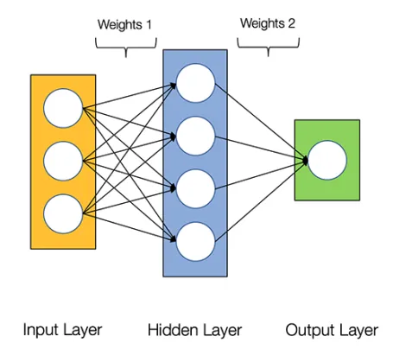
Neural Networks
Input Layer
Hidden Layers
Dense Layers (Full-connected Layers)
Activation Layer
Output Layer

Slide 17
Neural Networks
Modifier Layers
Dropout
Pooling Layer (MaxPool, MeanPool, SumPool, etc)
Masking Layer (if all x in group > i, substitute with 0)
Permute Layer ([a,b] [c,d] -> [a,c] [b,d]
Flatten Layer (m x n -> 1 x mn)
Reshape Layer (1 x mn -> m x n)
RepeatVector
Normalization Layer
Merge Layer (join using concat, ave, sum, mul, dot, etc)
Convolutional Layer (filters)

Slide 18
Neural Networks
Neural Network Hyperparameters
Gradient Descent Hyperparameters
Learning rate
Loss function
batch Size
Number of Training Iterations
Momentum (Momentum takes past gradients into account to smooth out the steps of gradient descent. It can be applied with batch gradient descent, mini-batch gradient descent or stochastic gradient descent)

Slide 19
Neural Networks
Neural Network Hyperparameters
Model Hyperparameters
Number of Hidden Units
Activation Sparsity
Nonlinearity
Weight Initialization
Random Seeds and Model Averaging
Preprocessing Input Data

Slide 20
Neural Networks
Hyperparameter optimization
Grid Search
Random Search
Hand-tuning

Slide 21
Neural Networks
NN Architectures
Perceptrons
Convolutional Neural Networks (ConvNet)
Recurrent Neural Networks (RNN)
Long / Short Term Memory (LSTM)
Gated Recurrent Unit (GRU)
Hopfield Network
Restricted Boltzmann Machine (RBM)
Deep Belief Networks (DBN)
Autoencoders
Generative Adversarial Network (GAN)

